Slide 1



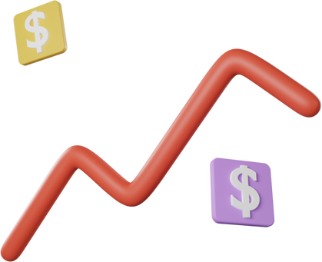
AN INVESTOR'S GUIDE TO PORTFOLIO OPTIMISATION

Slide 2





THE ERUDITES
URN
ANCHAL GARG
04
URN
DARSHAN DINESH KUMAR JAIN
11
URN
GAURAV MATHUR
14
URN
HRITIK VIJAY
15
URN
PREETHI VIJAYARAGHAVALU
26

Slide 3






ACKNOWLEDGEMENT
WE WOULD LIKE TO EXPRESS OUR SPECIAL THANKS AND GRATITUDE TO OUR PROFESSOR MR. GOURAB NATH, AS WELL AS ALL OUR STAFF FROM PRAXIS BUSINESS SCHOOL ,WHO WERE A GUIDANCE TO US THROUGHOUT THE COURSE AND GAVE US THE GOLDEN OPPORTUNITY TO DO THIS WONDERFUL PROJECT.

Slide 4





CONTENT
AGENDA
WORKFLOW
CREATIVE APPROACH
SHORTFALL
IDENTIFICATION
FINDINGS

Slide 5
OBJECTIVE
Business Plan
01
02
Market Reach
Risk
Nature
People still consider it a stigma to invest in stock market because of
its risky nature
Market
Reach
Only 1.2 crore individual invest in the market out of 138 crore individiuals
04
Framework
03
Filters
Framework
Filters
We have created technical and fundamental filters before fitting the core model.
We have created a framework
that will minimize risk and maximize the return
reallygreatsite.com

Slide 6


Elongated lifespans: 60’s is the new 30’s
01
The U.S. is a live example of how people are short of money in their old age.
02
MOTIVATION
Saving is significant what more important is an investment at an early age.
03
04
Therefore, the primary idea behind this project is to learn about the stock market

Slide 7




PROBLEM STATEMENT
01
Keeping the future in mind, each individual faces prior issues when it comes to investment.
How much to invest
02
03
When to invest
Where to invest
04
05
With Portfolio Optimization we are trying to strike a balance between the risk and return.

Slide 8
FLOWCHART
Technical Filtration of Close price
Hiererchical Risk Parity
01.
02.
03.
04.
05.
Close Price of Stocks
Fundamental Filtration
Findings

Slide 9

INVESTMENT IN
STOCKS

Slide 10
NO ENCLOSED PERIOD
POTENTIAL PROGRESS
•There won’t be a time frame for selling the stocks
•You hold the stocks or even sell it right after buying it
•Stock market can surpass its peer with good returns on investments
•The main reason most people invest in stocks is the potential return compared to alternatives such as mutual funds, fixed deposits, treasury bonds etc.
SEIZING STOCKS AS INVESTMENT
DIVERSIFICATION
TAX BENEFITS
•We can easily build a diversified portfolio across many different industries through stocks
•Depending on the tax slab, the long term capital gain is better than small returns from FDs

Slide 11

OBTAINING
MONETARY VALUE
OF
STOCKS

Slide 12
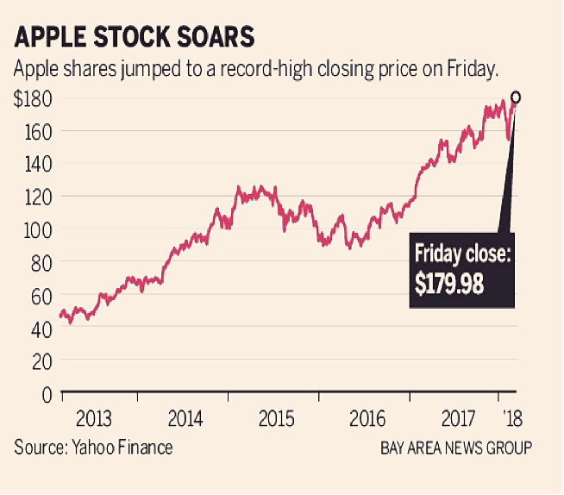
What is Closing Price of Stock?
•In layman’s terms , the closing price is the weighted average of all prices during the last half an hour of the trading hours.
It is not to be mistaken with the last trading price, which is the last or final price at which the stock was traded before the markets are closed.
Pros of Calculating Closing Price
The Closing Price is the exact medium for the investor to understand the market outlook and valuation of the stocks over time.
It makes it easier to understand the stock performance in the given period, which helps traders and investors take an informed decision.

Slide 13

TECHNICAL
FILTRATION

Slide 14
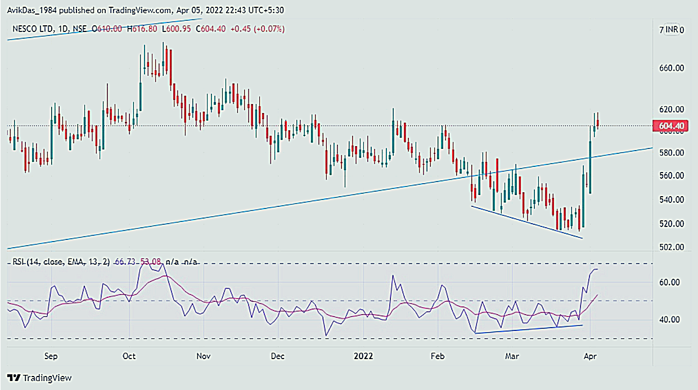
Technical Filtration Criteria
We perform the technical filtration based on RSI (Relative Strength Index)
What is RSI?
What is RSI Divergence?
Why do we use RSI?
let’s say we face a situation where the price moves in the opposite direction to the RSI indicator. This is what we call a Divergence. This is important because; We saw patterns of the breakouts, whenever there was an RSI divergence in the stock.

Slide 15
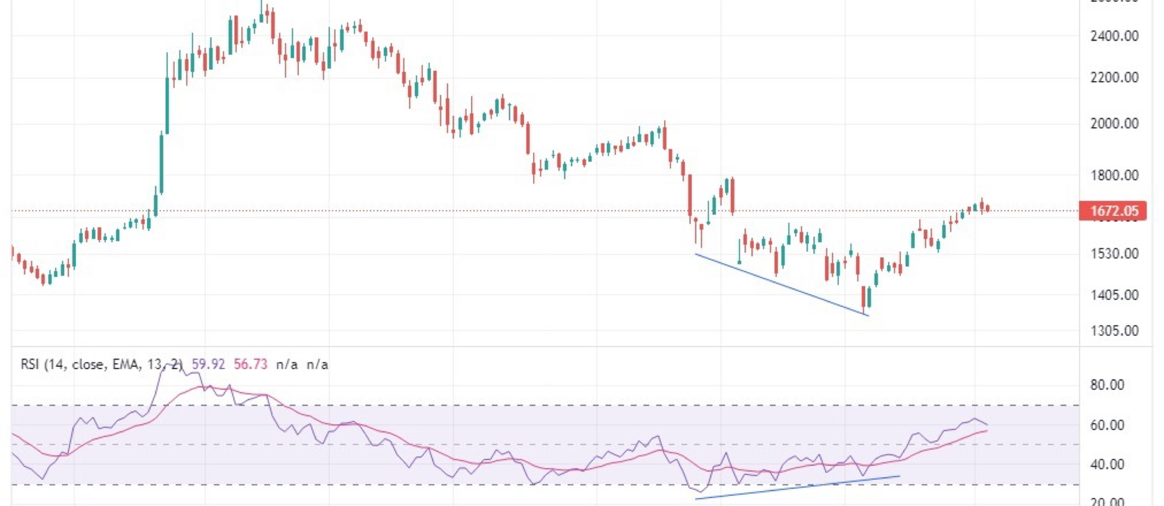
Proof :1
GODREJ’S PROPERTIES

Slide 16
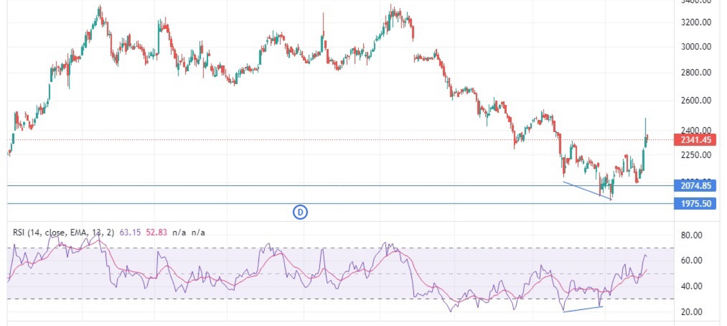
Proof:2
HDFC ASSET MANAGEMENT

Slide 17
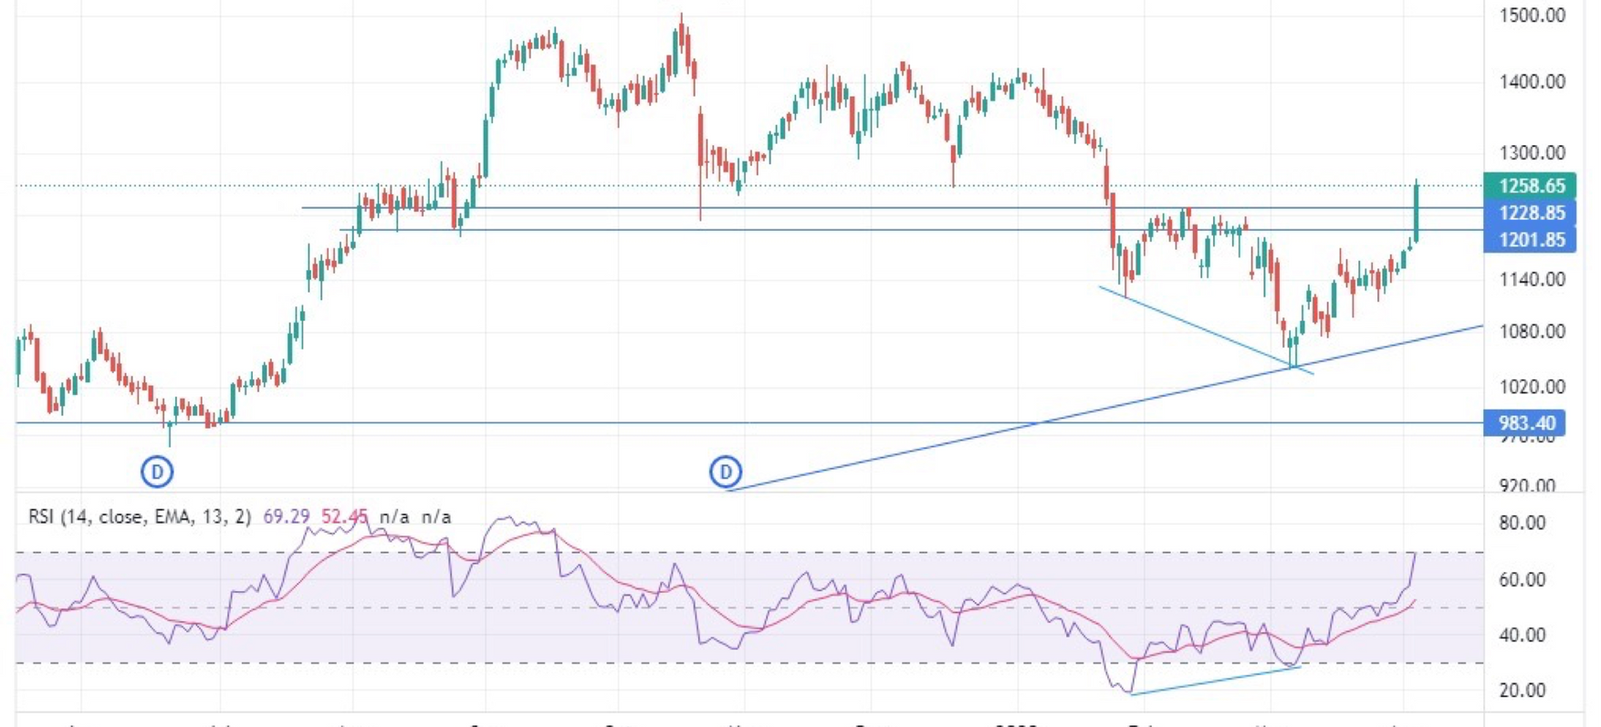
Proof :3
HAVEL’S INDIA

Slide 18
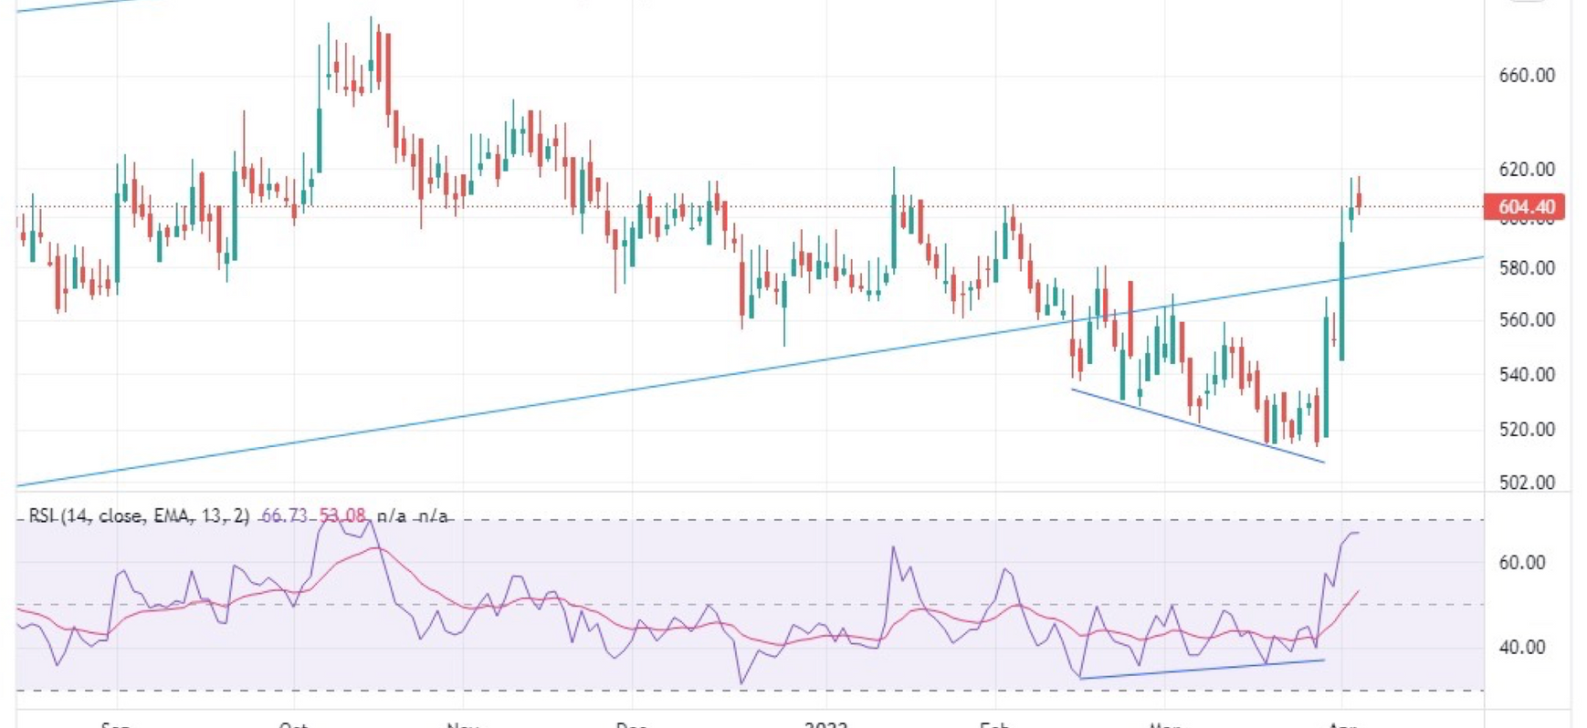
Proof :4
NESCO LIMITED

Slide 19



Indicators Used to Find Divergence
RSI
DIVERGENCE
SMA

Slide 20
RELATIVE STRENGTH INDEX
Momentum oscillator indicating the overbought or oversold conditions based on the magnitude of price changes of various assets.
The RSI is displayed as a line graph that moves between two extremes. Its reading can range from zero to 100.
When the RSI surpasses the horizontal 30 reference level, it is a bullish sign and when it slides below the horizontal 70 reference level, it is a bearish sign.
They are momentum indicators that can be used to pinpoint corrections and price breakouts and may point to the possibility of a reversal in trends.
So when the asset's price reaches a higher high and the RSI reaches a lower high, the trader can recognize a bearish divergence. A bullish divergence occurs in the opposite scenario.

Slide 21
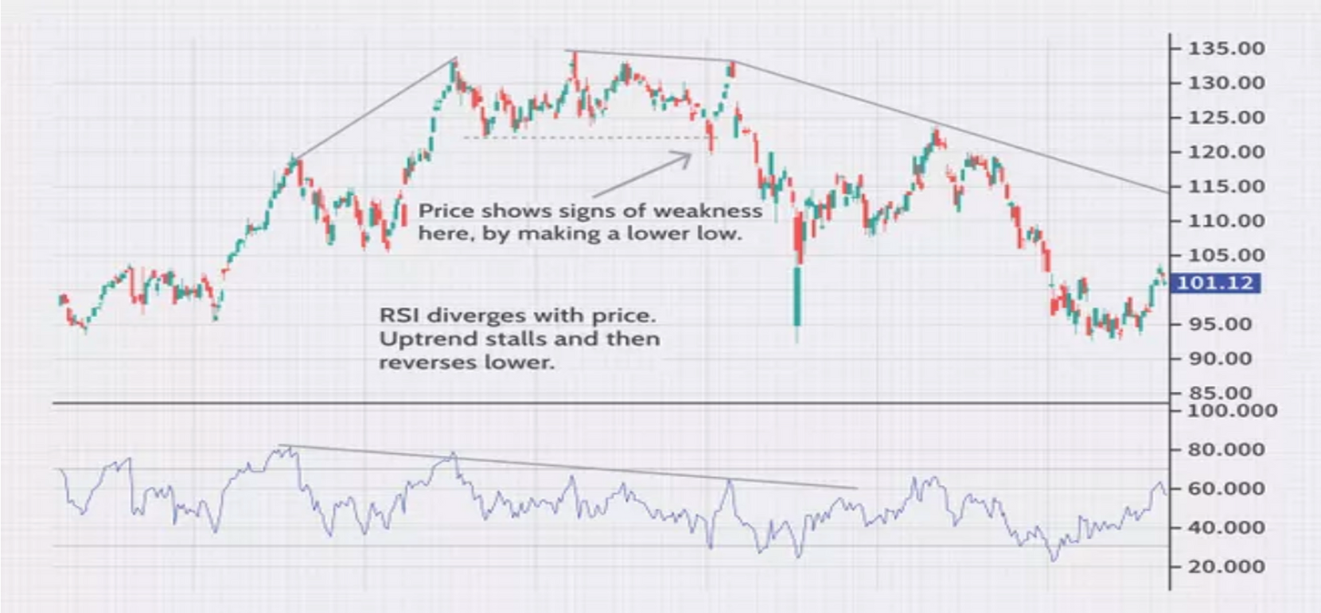
Traders who are looking for investment opportunities should look for RSI values that hit 30 or fall below that level. This allows them to look for investment options that may be undervalued where the price may increase in the future.

Slide 22


CORE INDICATORS OF TECHNICAL ANALYSIS
SMOOTHES OUT VOLATALITY AND EASIER TO VIEW PRICE TRENDS OF STOCKS
SMA
SMA MOVES UP PRICE IS INCREASING AND VICE VERSA
COMPUTED WITH AVG PRICE OVER SPECIFIED PERIOD

Slide 23
FUNDAMENTAL FILTRATION

Slide 24





FUNDAMENTAL FILTERS
After the Technical Filtration, we ponder from the investor’s point of view.
What if the investor has an interest in the company’s financial metrics?
On the same thought, we rundown the companies from a into a fundamental filter.
This filters the companies based on financials like profit and loss, balance sheet, income statement of the company.
Let us understand how?

Slide 25
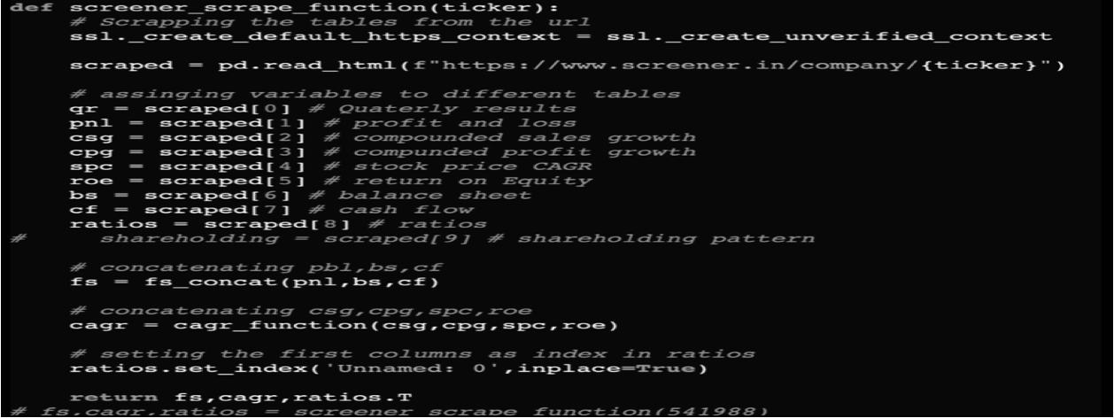
Data Scraping

Slide 26


01
We then concat the financial statements of the companies together for ease of data operations.
CONCATENATION
AND
DATA CLEANING
02
However, the data then needed to be prepared as some columns were in string format and some contained percentages.
03
For which we perform various operations to make the data ready to pass through the Fundamental Filter.
04
The investor can filter the companies based on their preference. Like, some investors may be interested in the Profit and Loss of a company.

Slide 27


Filtration
01
02
The financial statements data is then passed to the Fundamental filters preferred by the investor.
Based on which we get a set of companies through the Fundamental Filtration Process.
04
03
Once the Investor has gotten his set of companies , it is then sent to the HRP (Hierarchical Risk Parity)
The Fundamental Filters are dynamic.i.e., the companies can be selected as per the liking of the investor,viz, Net Profit, Cash Flow FIgures, Ratio Metrics.

Slide 28



WHAT IS HIERARCHICAL RISK PARITY
HRP is a risk-based portfolio optimisation algorithm introduced by Marcos Lopez de Prado in the year 2016.
“Building Diversified Portfolios that Outperform Out of Sample” was his paper title.
It consists of three steps for weight allocation of assets.
by Prof. Henderson
Interpret the results and write your conclusion.

Slide 29

Hierarchical Risk Parity-
Flow Diagram
03
OPTIMUM WEIGHTS
02
RECURSIVE BISECTION AND ASSETS WEIGHTS COMPUTATION
01
QUASI-DIAGONALIZATION OF THE ASSETS CORRELATION MATRIX
HIERARCHICAL CLUSTERING OF THE ASSETS
FILTERED
STOCKS

Slide 30
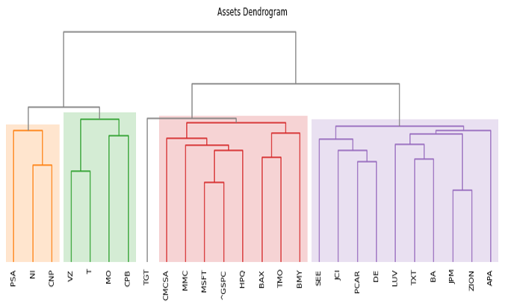
Step -1 Hierarchical Tree Clustering
Group similar investments into clusters based on their correlation matrix.
This step uses a Hierarchical clustering algorithm
The dendrogram shows similar assets in a chart format.
In the end we have one big cluster with small nested clusters inside it.
Final Dendrogram

Slide 31
Hierarchical Risk Parity-
Flow Diagram
03
OPTIMUM WEIGHTS
02
RECURSIVE BISECTION AND ASSETS WEIGHTS COMPUTATION
01
QUASI-DIAGONALIZATION OF THE ASSETS CORRELATION MATRIX
HIERARCHICAL CLUSTERING OF THE ASSETS
FILTERED
STOCKS

Slide 32
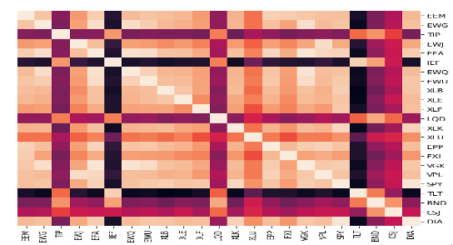
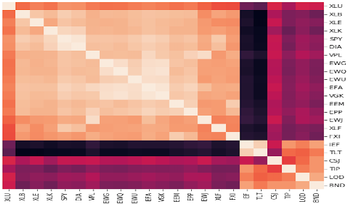
Step-2 Matrix Seriation
● Reorganize the covariance matrix so similar investments will be placed together.
Dissimilar correlations will be placed far apart.
Unclustered correlations
Before arrangement or seriation, we can see that the clusters are broken into small sub sections.
We can see that after seriation, the clustering structure becomes more evident.
Clustered correlations

Slide 33
Hierarchical Risk Parity-
Flow Diagram
03
OPTIMUM WEIGHTS
02
RECURSIVE BISECTION AND ASSETS WEIGHTS COMPUTATION
01
QUASI-DIAGONALIZATION OF THE ASSETS CORRELATION MATRIX
HIERARCHICAL CLUSTERING OF THE ASSETS
FILTERED STOCKS

Slide 34
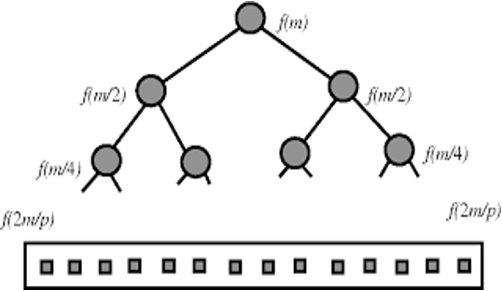
Step-3 Recursive Bisection and Weights Computation
Initially all the assets are assigned similar weights
In a top-down manner, we break the clusters into sub-clusters
The process in which a function calls itself directly or indirectly is called recursion.
A binary tree is formed with right and left clusters.
Using a weighting factor, weights are calculated for all the assets.

Slide 35
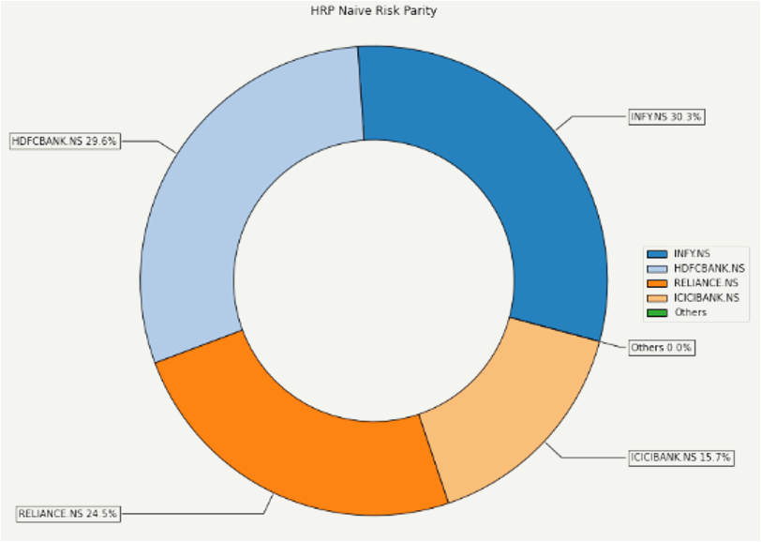
PYTHON OUTPUT OF HRP WITH WEIGHT ALLOCATION

Slide 36

CREATIVE APPROACH
We have created a framework which uses Techno-Funda filters integrated with Machine Learning to filter the companies
Along with RSI, we have used Breakout to filter the stocks.
We have used specific filters to segregate the Financial and Non-Financial companies

Slide 37
ASSUMPTIONS
FINANCIAL COMPANIES
• Financing Margin > 12%
• Net Profit > 0 (Should be Positive)
1) For fundamental filters we screened as
NON - FINANCIAL COMPANIES
• Operating Profit Margin
>= 5%
• Cash flow from Operation
> 0 (Should be positive)
• Net Cash Flow > 0 (Should be positive)
• Debt/ Total Asset < 40%
• Other Income/Total revenue < 10%
•Investment/ Total Assets
< 20%
2) Buying and selling at the closing price
3) No transactions cost
4) We won’t invest if only one company is shortlisted

Slide 38

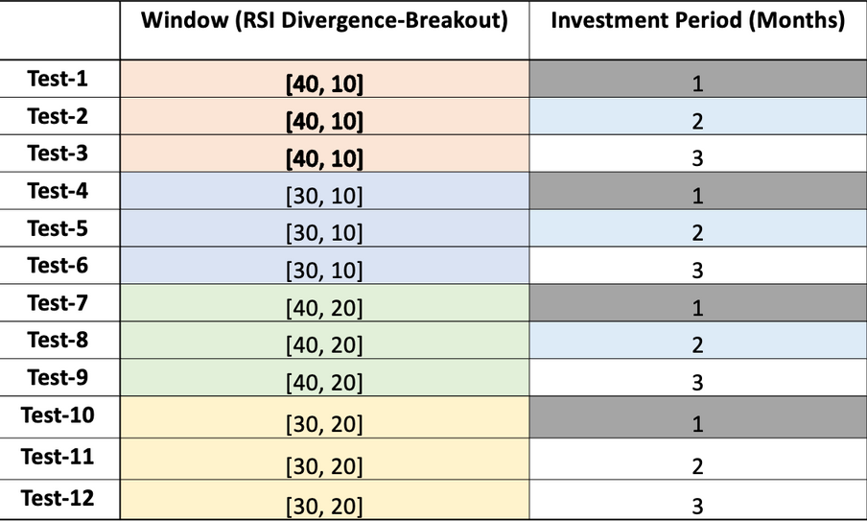
ABOUT THE EXPERIMENT
• 4-year cycle under consideration
• Cycles Start with 30th of April of each year i.e., 2018-2019, 2019-2020, 2020-2021 & 2021-22
• For each year we are choosing 4 Divergence-Breakout window: 40-10, 30-20, 40-20 & 30-20
• For each window we have chosen 3 types of portfolio churning rates, i.e. 1 month, 2 month & 3 month
• Therefore, in total we have conducted
• 4 Years x 4 Windows x 3 Churning period
• 48 Tests.

Slide 39
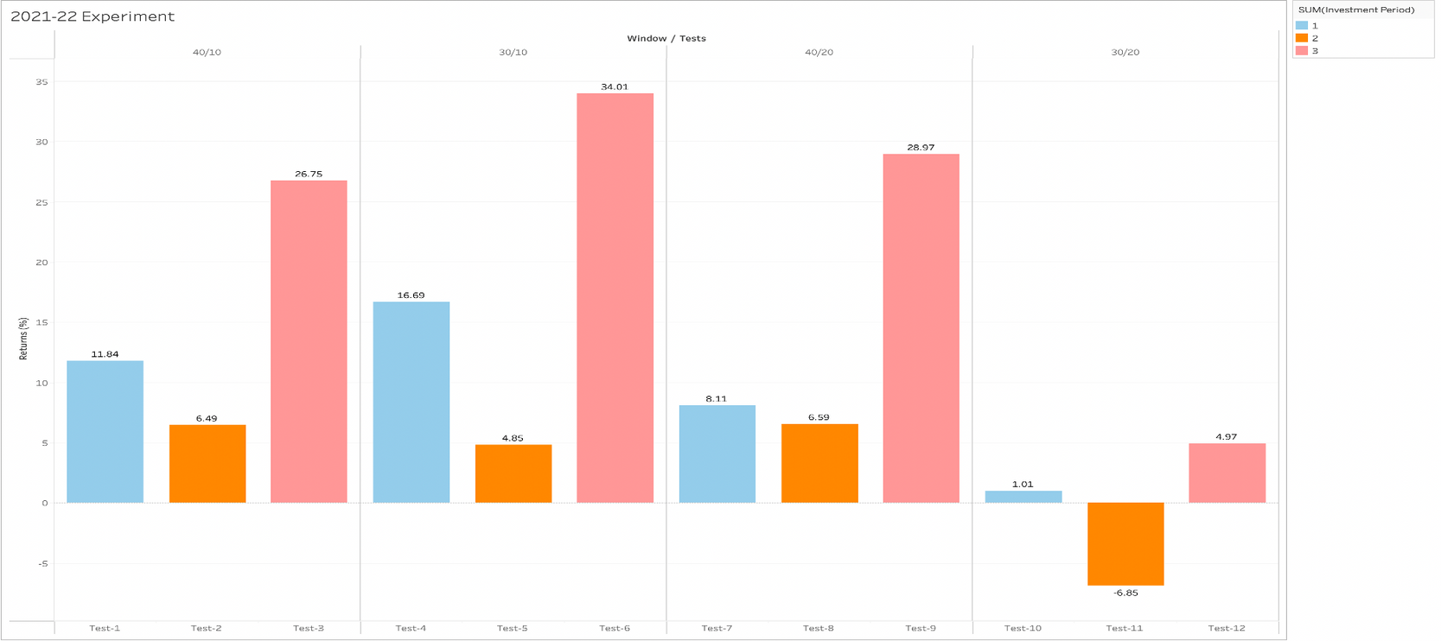
2021 - 2022 Exp.
• 3 Months portfolio churning giving higher returns
• 2 months portfolio churning is given less than 10% return in each window
Investment Periods
1 Month
2 Month
3 Month

Slide 40
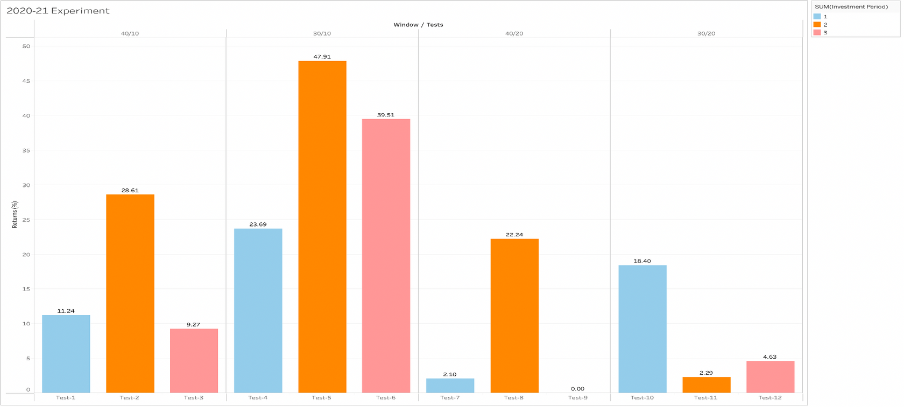
2020 - 2021 Exp.
Investment Periods
Window 30/10 giving higher returns
2 month’s portfolio churning is performing better
1 Month
2 Month
3 Month

Slide 41
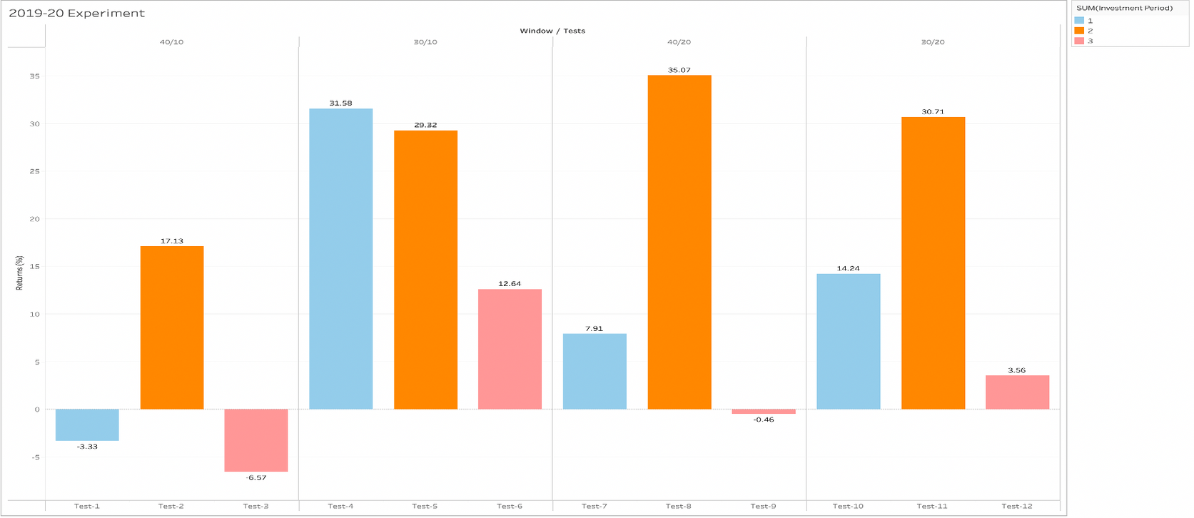
2019 - 2020 Exp.
2-month portfolio churning giving us better returns
1 month portfolio churning has volatile returns
However, 30/10 window performs betters irrespective of the churning rate
Investment Periods
1 Month
2 Month
3 Month

Slide 42
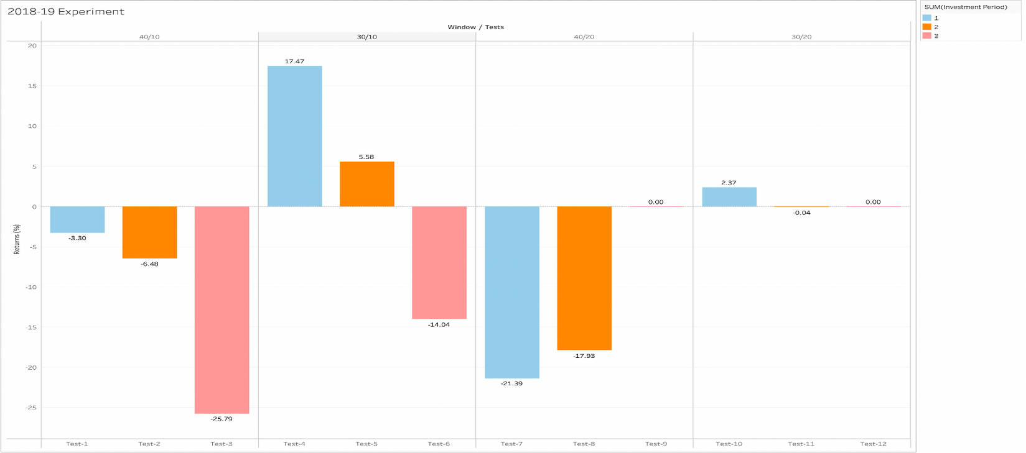
2018 - 2019 Exp.
Investment Periods
None of the strategies are performing
Relatively, 30/10 window performed better.
1 Month
2 Month
3 Month

Slide 43
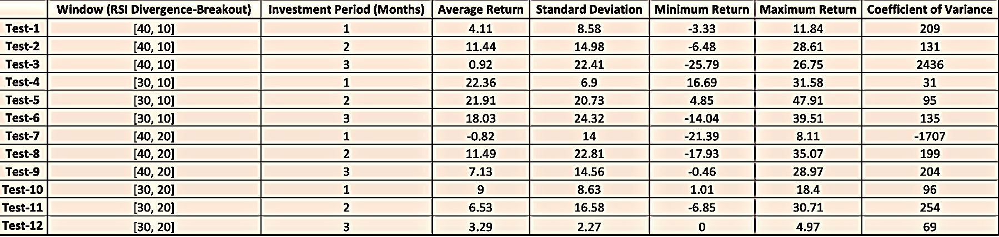
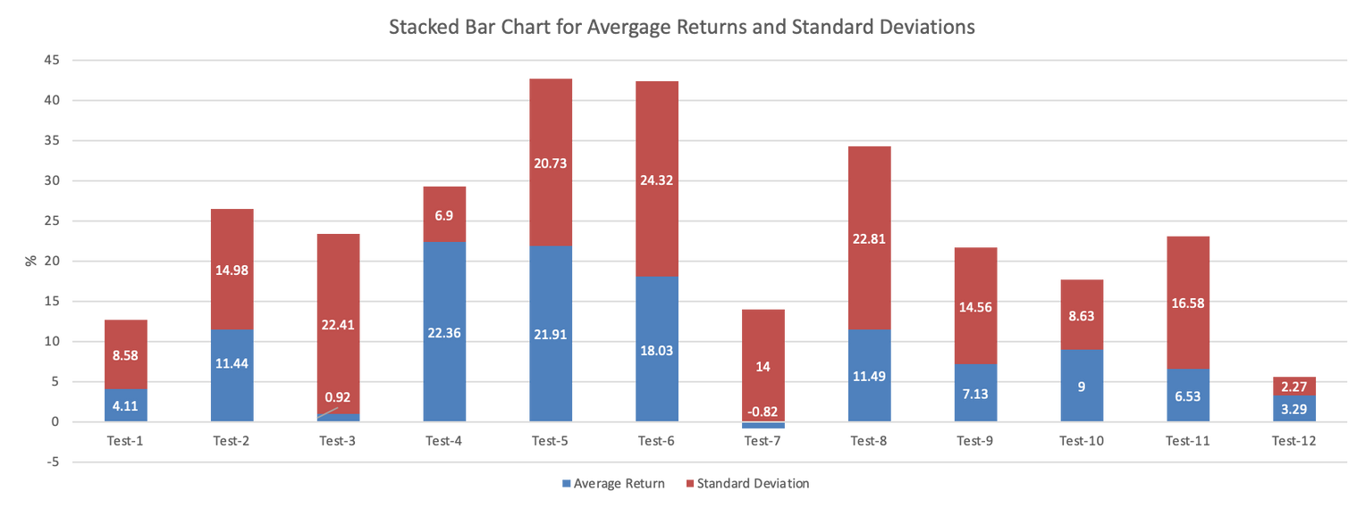
Average Return Throughout the years for
each strategy

Slide 44




Shortfall Identification
1
2
3
Adding more technical pattern to learn
Adding more financial metrics to filter
Giving flexibility to investor to choose companies.

Slide 45
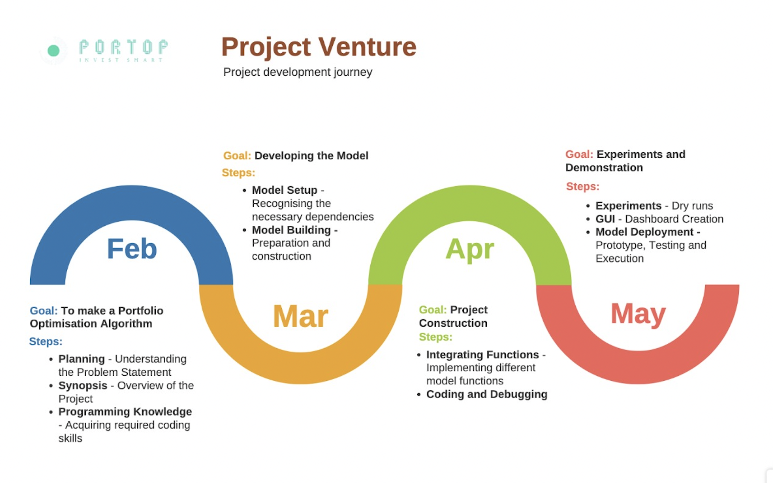

Slide 46


